Slide 1
SQL Project
By: Isa Abdulla

Slide 2
Problem Statement
The company lacks clear visibility into workforce demographics such as age distribution, employment type, and pay type preferences. Without these insights, HR may face challenges in planning recruitment, retention strategies, and payroll management.

Slide 3
HR Analysis
Age distribution – identifying the top 5 most common ages among employees.
Employment type – comparing full-time vs. part-time staff.
Pay type – determining the most widely used payment method.
Purpose: Provide a clear snapshot of workforce demographics and payment trends.

Slide 4


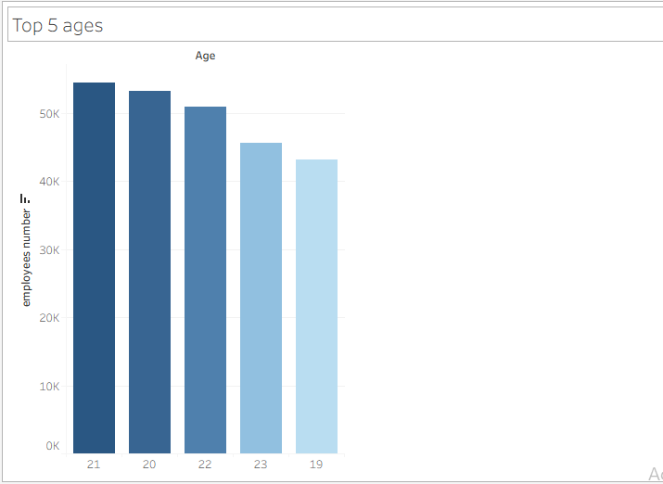

Age distribution
This gives us an idea of which age groups dominate our workforce.
Understanding age distribution can help HR in planning training, succession planning, and employee engagement strategies.

Slide 5
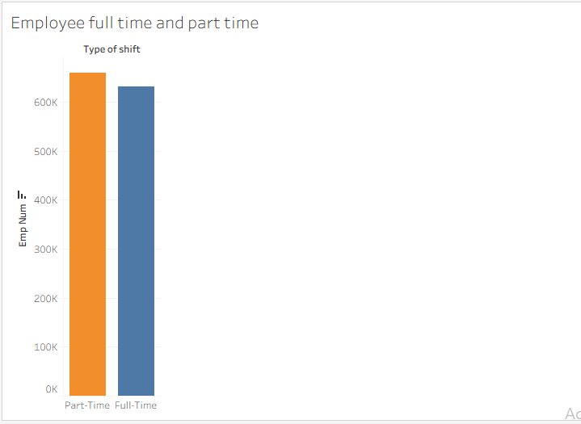
Employment type
highlights the company’s staffing structure.
A higher number of full-time employees usually means more long-term workforce stability

Slide 6
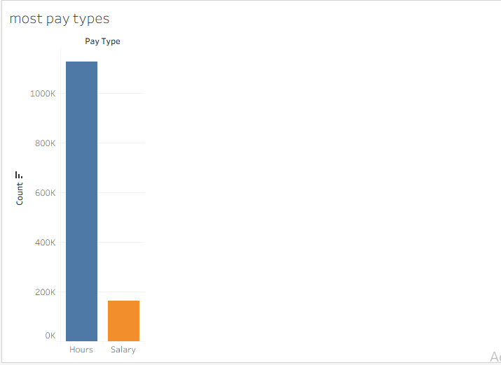
Pay types
This information helps HR and Finance understand compensation trends and ensure that the payroll system supports employee needs effectively.

Slide 7
Recommendations
Age Distribution
Develop targeted training and career development programs for the most common age groups.
Plan succession strategies if certain age clusters are nearing retirement.
Employment Type
Assess if the current balance between full-time and part-time staff supports business needs.
Consider adjusting hiring strategies to optimize workforce flexibility and stability.
Pay Types
Standardize the most common pay type to simplify payroll processing.
Offer flexible pay options if employee preferences vary, to improve satisfaction.

Slide 8
Thank you

